Slide 1

Customer Shopping Behavior Analysis
Uncovering insights from 3,900 transactions across product categories — spending patterns, customer segments, and subscription behavior to guide strategic business decisions.

Slide 2
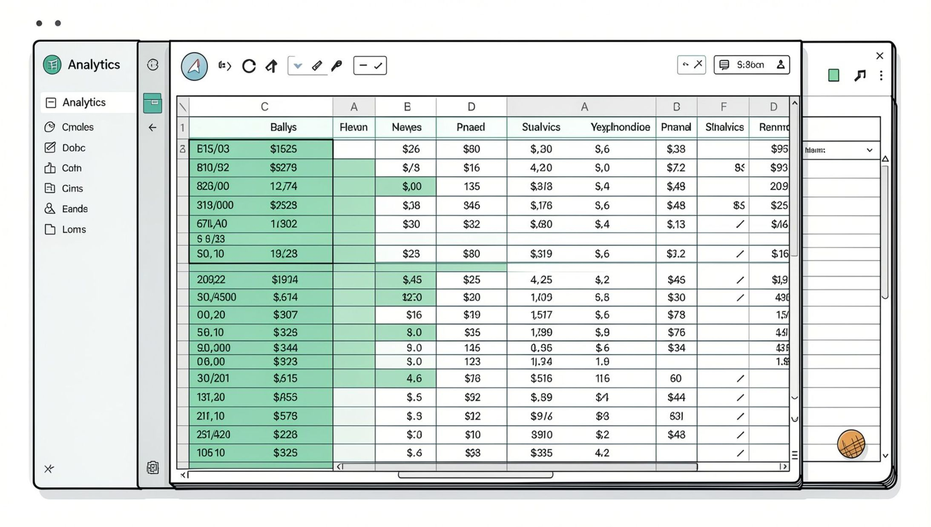
Dataset at a Glance
Key features include customer demographics (Age, Gender, Location, Subscription Status), purchase details (Item, Category, Amount, Season), and shopping behavior (Discount, Frequency, Review Rating, Shipping Type).
3,900 Rows
18 Columns
37 Missing
Individual purchase transactions
Rich feature set
Values in Review Rating

Slide 3


Data Preparation in Python
Load & Explore
Imported via pandas; used df.info() and .describe() for initial structure and statistics.
Clean & Standardize
Imputed missing Review Ratings using median per category; renamed columns to snake_case.
Feature Engineering
Created age_group by binning ages and purchase_frequency_days from purchase data.
Database Integration
Connected to PostgreSQL and loaded the cleaned DataFrame for SQL analysis.

Slide 4

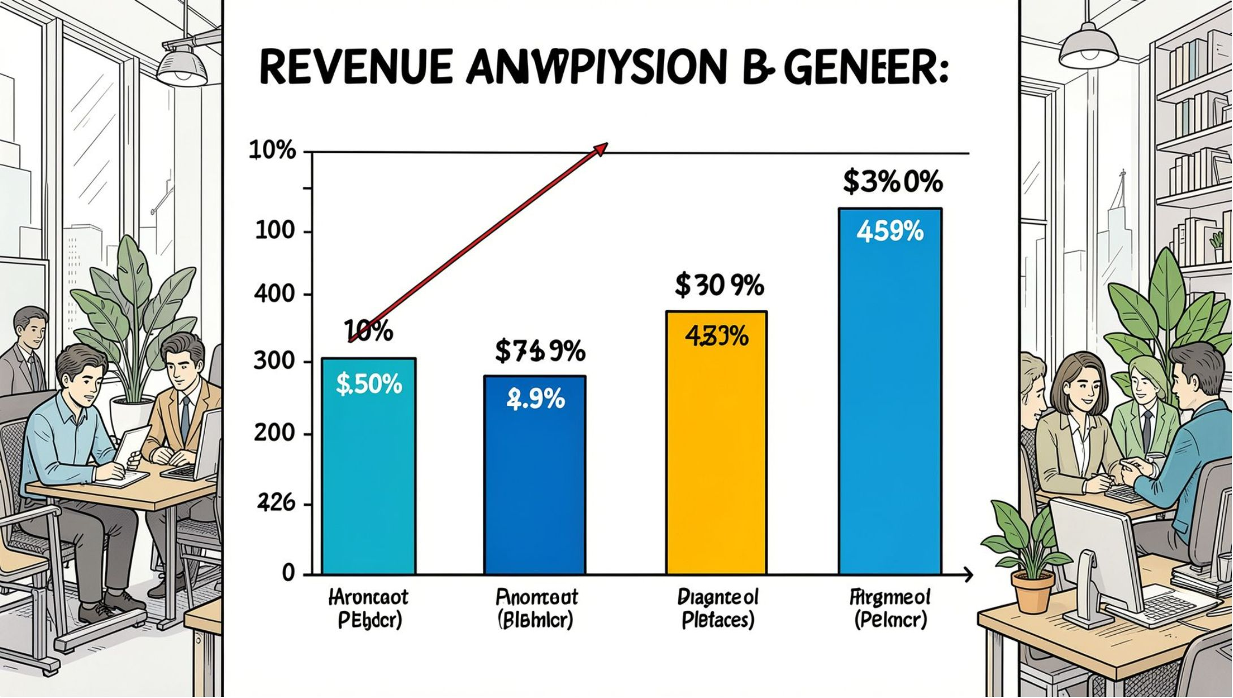

Revenue & Spending Insights
Revenue by Gender
Compared total revenue generated by male vs. female customers.
High-Spending Discount Users
Identified customers who used discounts but still spent above the average purchase amount.
Revenue by Age Group
Calculated total revenue contribution of each age group.

Slide 5

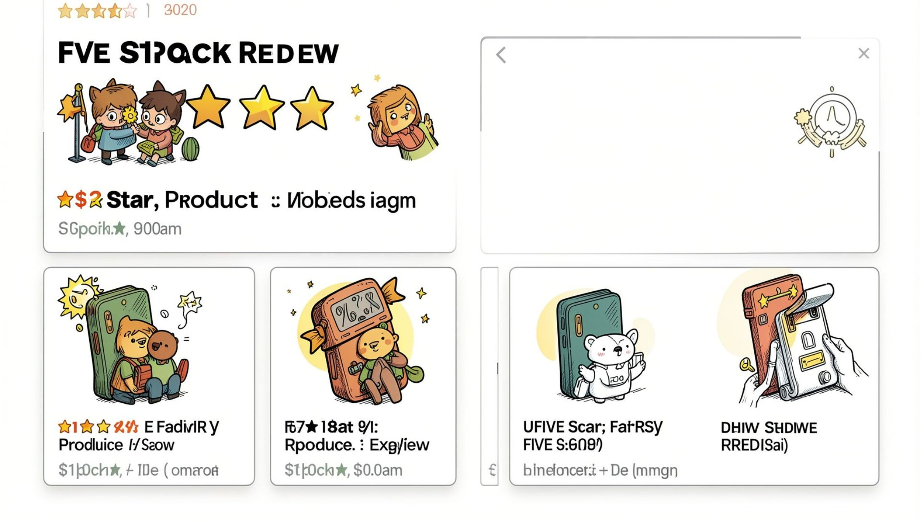

Products & Ratings
Top 5 Products by Rating
Found products with the highest average review ratings.
Top 3 Products per Category
Listed the most purchased products within each category.
Discount-Dependent Products
Identified 5 products with the highest percentage of discounted purchases.
Products Purchased by 100+ Customers
Identified which products have been purchased by more than 100 customers.

Slide 6
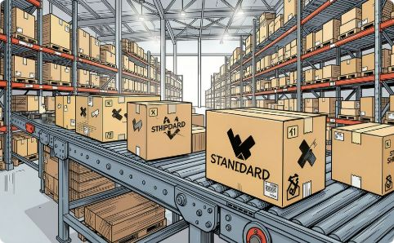
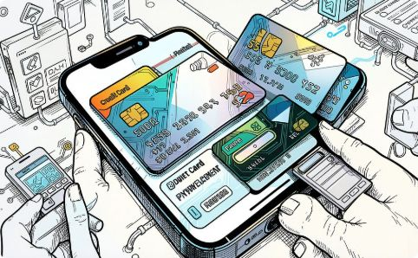
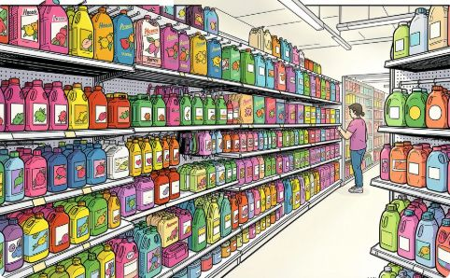
Shipping, Payments & Categories
Shipping Type Comparison
Payment Method Analysis
Category Purchase Analysis
Compared average purchase amounts between Standard and Express shipping.
Which payment method generates the highest average purchase amount?
Average purchase amount per product category — which categories exceed $50?

Slide 7
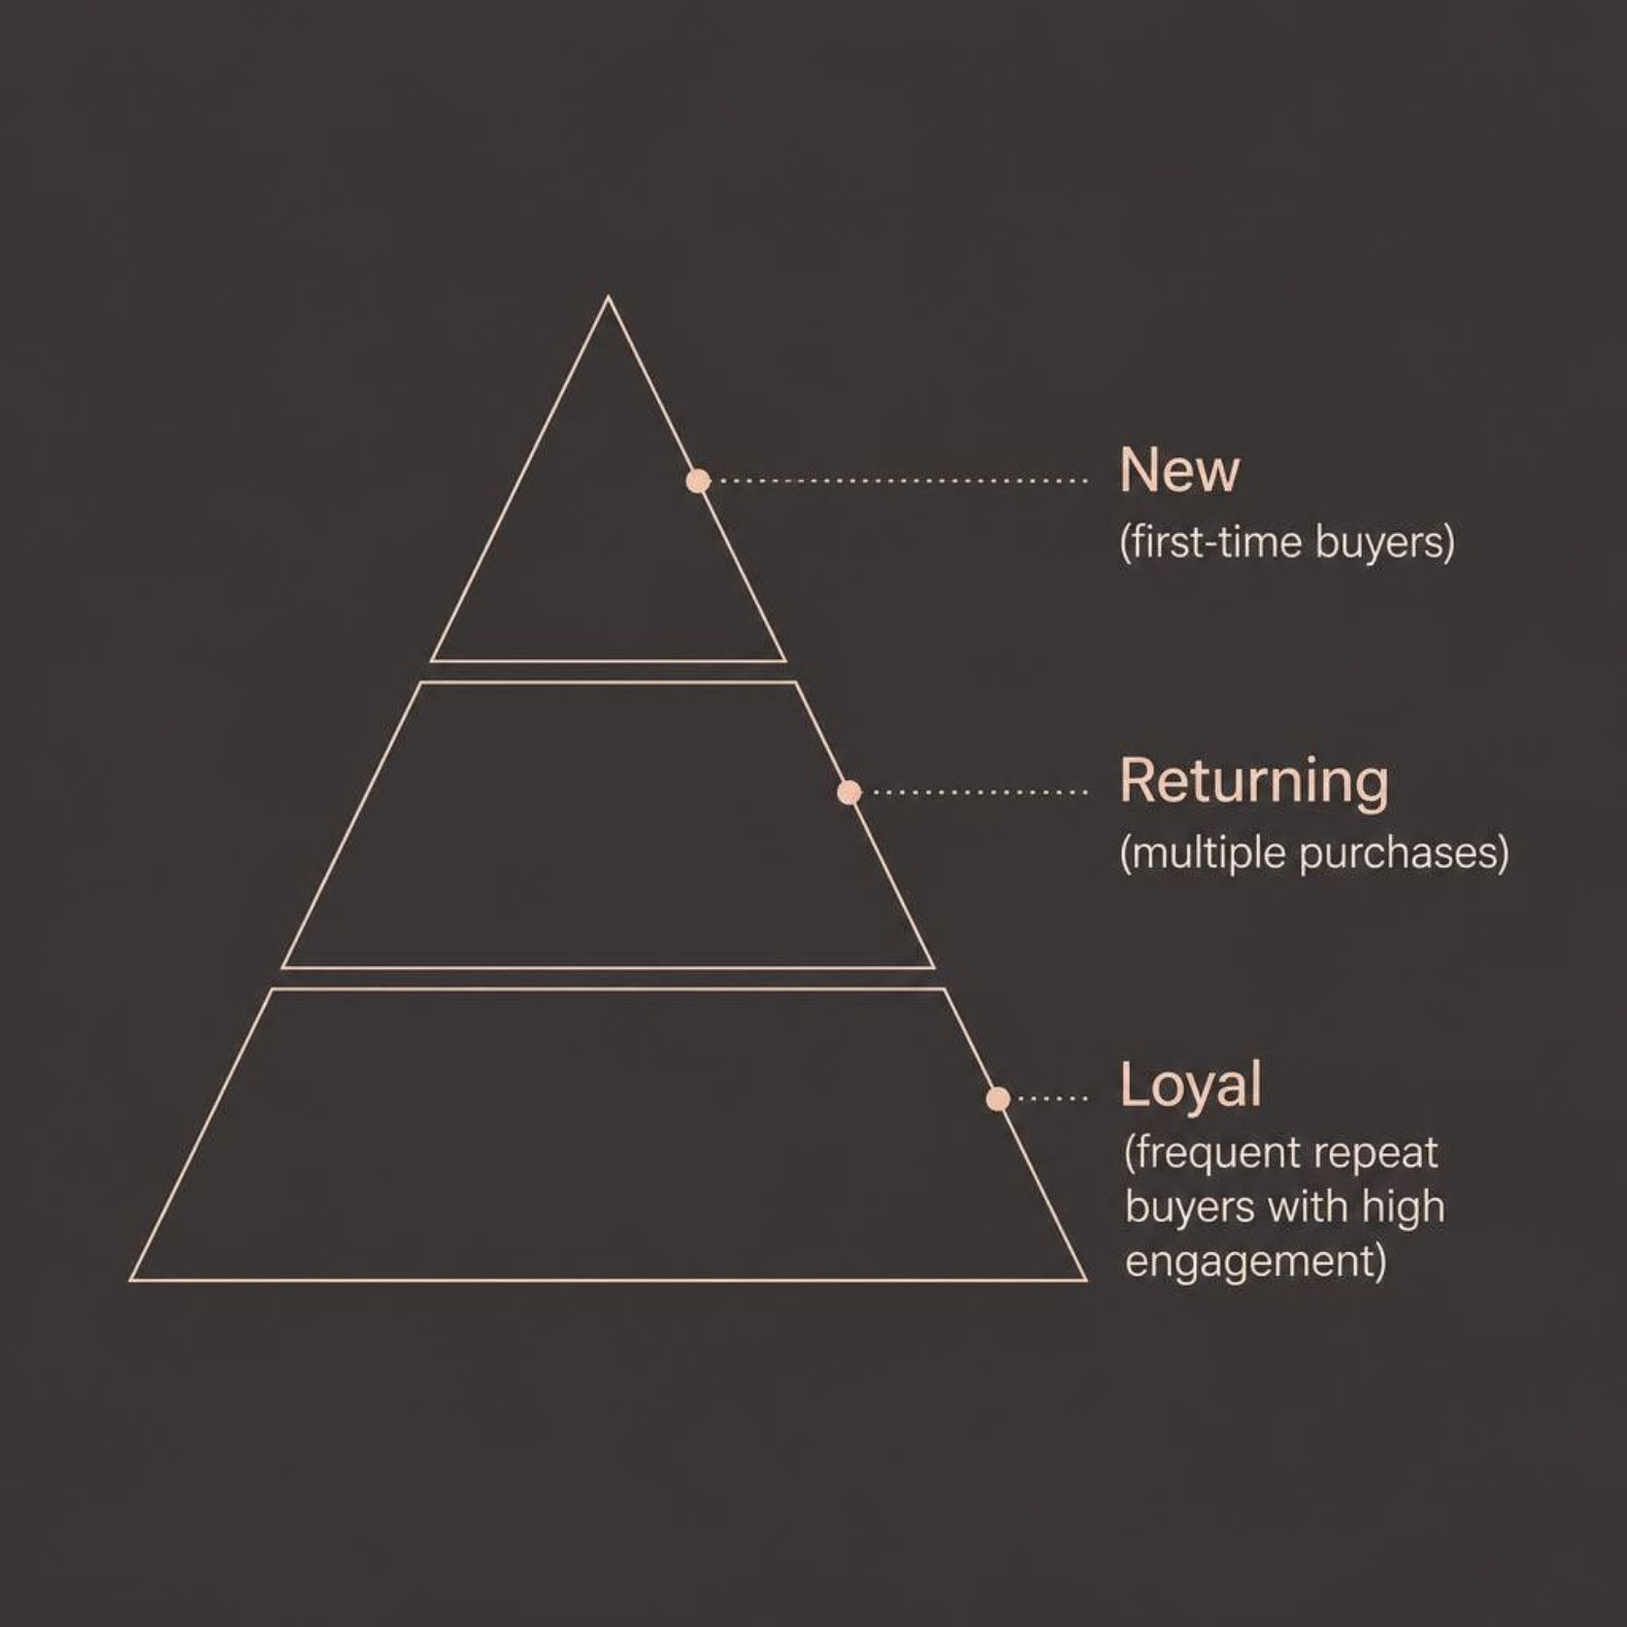

Customer Segmentation
Customers were classified into New, Returning, and Loyal segments based on purchase history. Repeat buyers with more than 5 purchases were analyzed to check whether they are more likely to subscribe.
Repeat buyers with >5 purchases were checked for subscription likelihood — a key lever for loyalty programs.

Slide 8
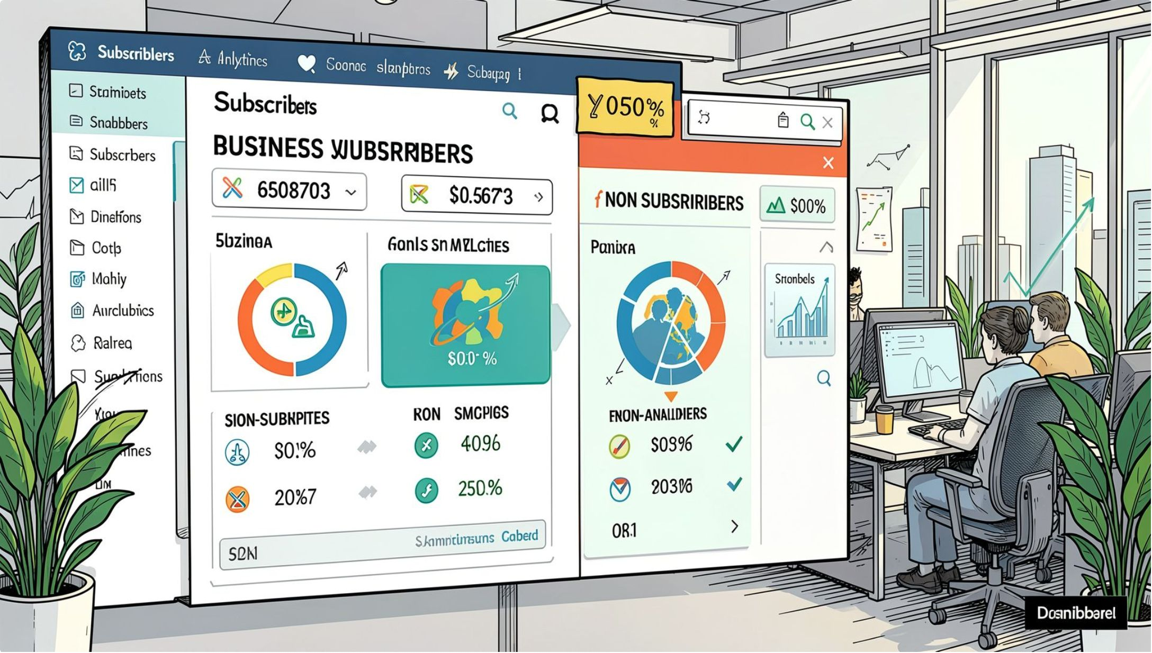


Subscriber & Location Analysis
Subscribers vs. Non-Subscribers
Compared average spend and total revenue across subscription status.
Location Analysis
Which locations have the highest number of customers and what is their total revenue?

Slide 9
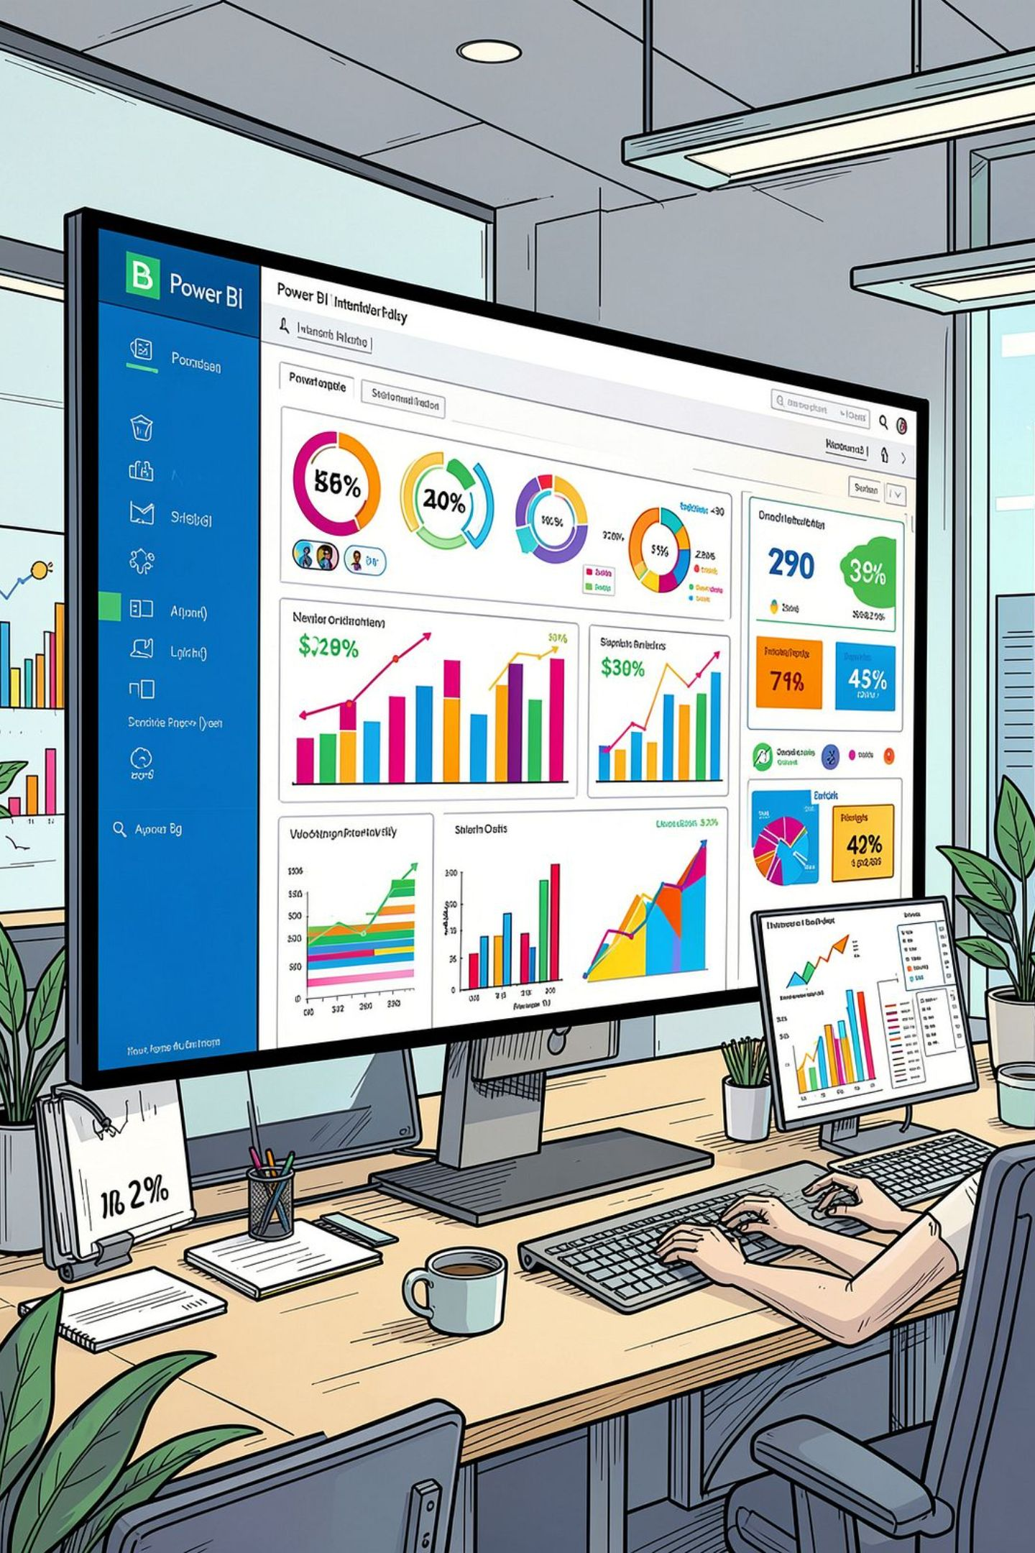
Power BI Dashboard
An interactive Power BI dashboard was built to present all insights visually — enabling stakeholders to explore revenue, segments, product performance, and subscription trends at a glance.

Slide 10





Business Recommendations
Boost Subscriptions
Loyalty Programs
Review Discount Policy
Promote exclusive benefits for subscribers.
Reward repeat buyers to move them into the "Loyal" segment.
Balance sales boosts with margin control.
Product Positioning
Targeted Marketing
Highlight top-rated and best-selling products in campaigns.
Focus efforts on high-revenue age groups and express-shipping users.

